Slide 1


RPPOOP PROJECT

Slide 2
Members of Group
612203193 Komal Waghmore
612203195 Chanchal Wankhade

Slide 3
Recipe Finder

Slide 4


Project Overview
Problem statement Introduction Background Project goals Data
Result Conclusion

Slide 5
Problem statement
That allows users to easily find and share
recipes.

Slide 6
Introduction
Purpose of this project is users can explore an extensive collection of recipes from various cuisines, dietary preferences, and cooking styles, helping them find new dishes to try and expand their culinary repertoire.

Slide 7


Background
The Python code sets up a web application using the Flask framework to search for recipes using the Spoonacular API and display them.
Import Flask, render_template, request, requests and unquote.

Slide 8
Project Goals
01
02
User-Friendly Interface: Develop a visually appealing and intuitive user interface that makes it easy for users to navigate the app, search for recipes, and access features.
Search and filtering:
To find recipes based on various criteria such as ingredients, cuisine type, cooking time, and difficulty level. Implement filters to refine search results and improve discoverability.

Slide 9
Data
API Integration: Integrating with external APIs such as Spoonacular recipe API key.

Slide 10
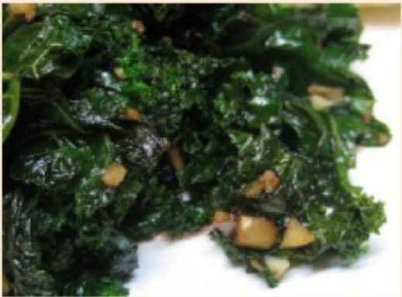
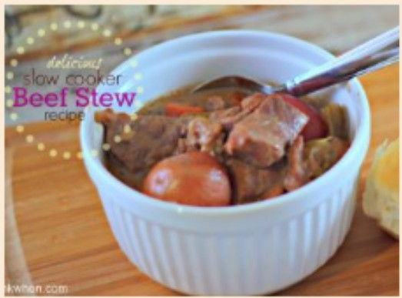
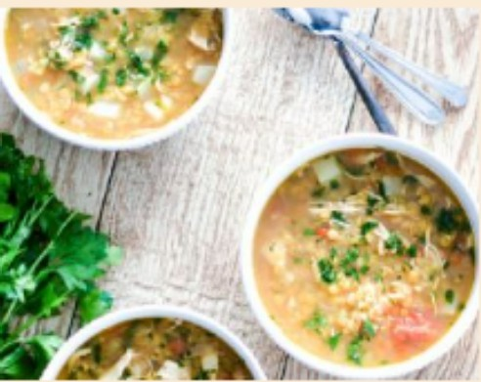
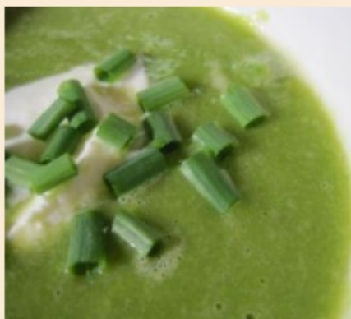
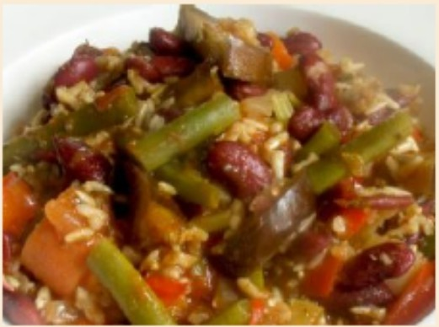
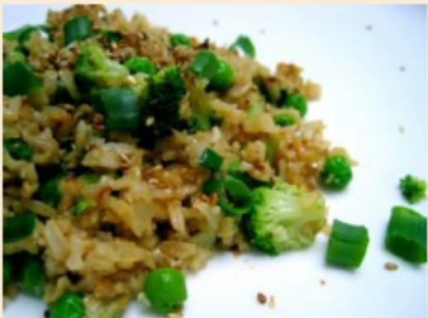
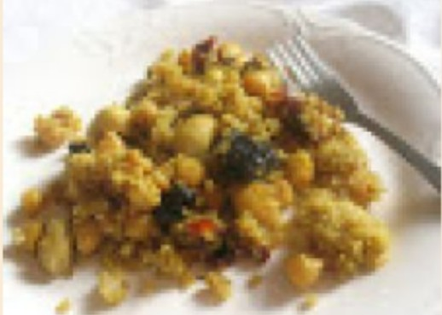
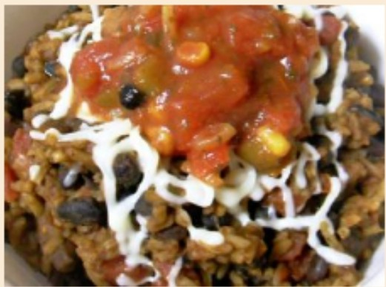
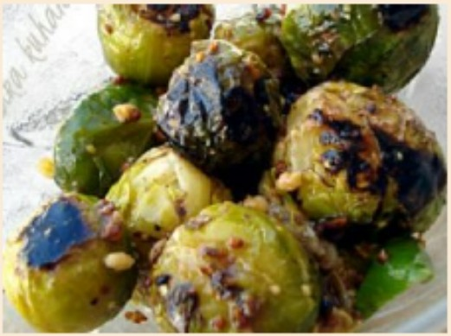
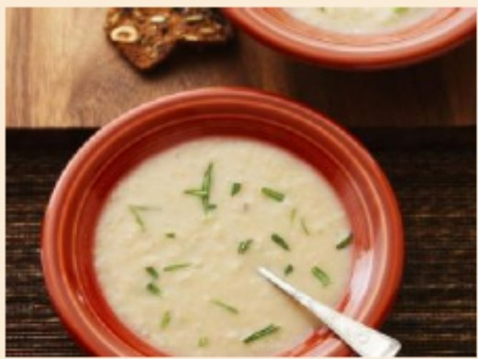
._SI_e_ar_ch_t_or_r_ec_ip_e_s ,I [ Search ] Home
Results for ""
Here are some of them :
Red Lentil Soup with Chicken and Turnips
Asparagus and Pea Soup: Real Convenience Food
Garlicky Kale
Slow Cooker Beef Stew
Red Kidney Bean Jambalaya
Cauliflower, Brown Rice, and Vegetable Fried Rice
Quinoa and Chickpea Salad with Sun-Dried Tomatoes and Dried
View
View
View
View
View
View
View
Easy Homemade Rice and Beans
Tuscan White Bean Soup with Olive Oil and Rosemary
Crunchy Brussels Sprouts Side Dish
View
View
View

Slide 11


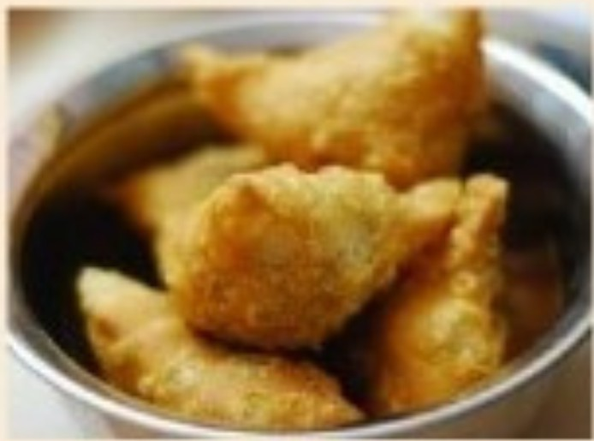


Results for -samosa"
Here are- ome of them :
Baked Indian Samosas
View
NOTE:Write the correct spellings.

Slide 12


Conclusion
We've worked hard to make it easy for anyone to cook delicious meals at home. Our website gives the recipe and the ingredients with their procedure for cooking this food.

Slide 13




